Slide 1
RL’s Properties

Slide 2
Closure Properties of Regular Languages (Intersection)
Let L and M be languages over alphabet ∑. Then L ∩ M is the language that contains all strings that are in both L and M
Intersection of Regular Languages
  If L1 and L2 are regular languages then L1 ∩ L2 is also a regular language. i.e. Set of regular languages is closed under intersection

Slide 3
Closure Properties of Regular Languages (Intersection)
Proof
By Demorgan’s Law
L1 ∩ L2 = (L1’ U L2’)’
        = (L1’ + L2’)’
This implies that L1 ∩ L2 consists of all words that are not is either L1’ or L2’. As L1 and L2 are regular languages so are L1’ and L2’. There union L1’ + L2’ is also a regular language.

Slide 4
Closure Properties of Regular Languages (Intersection)
L1 = all strings with a double a
L2 = all strings with an even number of a’s
Both are regular languages and they have following RE respectively
R1 = (a+b)*aa(a+b)*
R2 = b*(ab*ab*)*
Both languages are regular, Kleen’s Theorem says that they can also be defined by FAs
a
a,b
b
a
b
b
a
-
+
-
+
b
FA1
a
FA2

Slide 5
Closure Properties of Regular Languages (Intersection)
Complements of FAs
a
a,b
b
a
b
b
a
x1-
+
+
x3
y1-
y2+
b
FA1’
a
FA2’
Join the machines to get FA3 = FA1’ + FA2’ which defines the language (L1’ + L2’)
Reverse the final status of each state of FA3 to get (FA1’+FA2’)’ that defines L1 ∩ L2
Apply the TG to RE conversion over FA3 to get r3 that defines the intersection of both languages

Slide 6
Closure Properties of Regular Languages (Intersection)
Second Method of Intersection
a
a,b
b
a
b
b
a
x1-
x2
x3+
y1-
+
y2
b
FA1
a
FA2
Join both the machines to get FA3 = FA1+FA2 that defines L1+L2
FA3 consists of states of both FA1 and FA2. Remove all the + and put a + only at a state where the corresponding x and y components both are final

Slide 7
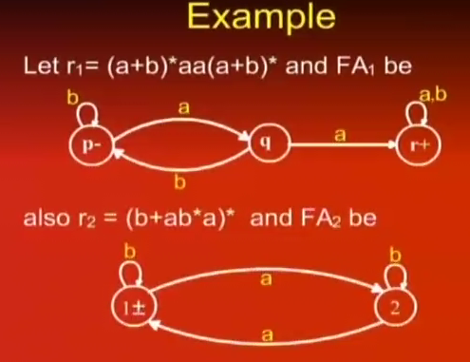

Slide 8
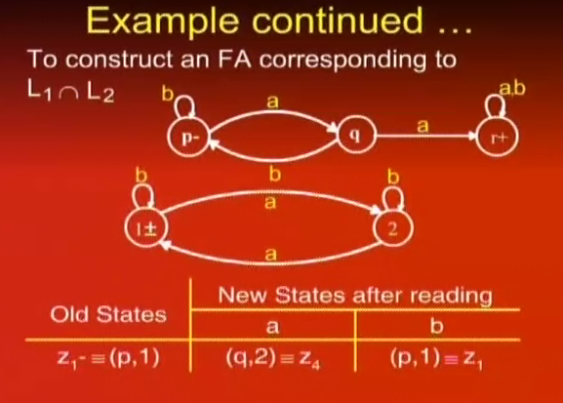

Slide 9
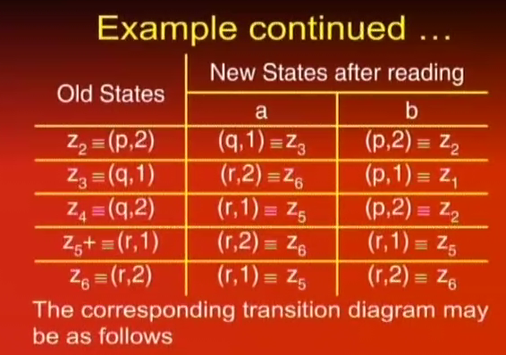

Slide 10
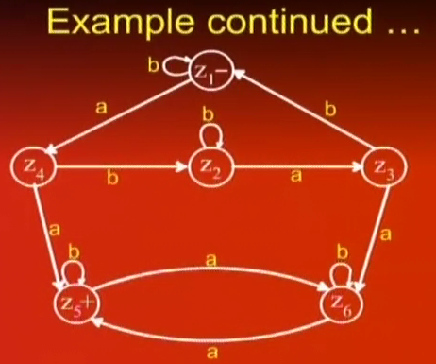

Slide 11
Closure Properties of Regular Languages (Closure)
If L is a regular expression then L* consists of all strings formed by the concatenation of arbitrarily many factors of L
Closure Property
  If L is a regular language so is L*

Slide 12
Closure Properties of Regular Languages (Closure)
Proof (By regular expression)
If a regular lanugage L is defined by a regular expression r then the language L* can be defined by r*. Thus L* is a regular language

Slide 13
Closure Properties of Regular Languages (Closure)
Proof (By Machines)
-
Λ
TG1
Λ
+

Slide 14
Closure Properties of Regular Languages (Concatenation)
If L1 and L2 are two regular languages then L1L2 contains all words formed by concatenation of a word from L1 with a word from L2
Concatenation of Regular Languages
  If L1 and L2 are two regular languages then so is L1L2.

Slide 15
Closure Properties of Regular Languages (Concatenation/Product)
Proof (By Regular Expression)
If L1 and L2 are regular languages then there are two regular expressions r1 and r2 which define these respectively. The language L1L2 can be defined by r1r2 which is also a regular expression. Hence L1L2 is also a regular language.

Slide 16
Closure Properties of Regular Languages (Concatenation/Product)
Proof (By Machines)
Λ
-
1
2
+
TG1
TG2

